Slide 1
Relational Database Design by ER- and
EER-to-Relational Mapping
Chapter - 2

Slide 2
Outline
ER-to-Relational Mapping Algorithm
  Step 1: Mapping of Regular Entity Types
  Step 2: Mapping of Weak Entity Types
  Step 3: Mapping of Binary 1:1 Relation Types
  Step 4: Mapping of Binary 1:N Relationship Types
  Step 5: Mapping of Binary M:N Relationship Types
  Step 6: Mapping of Multivalued attributes
  Step 7: Mapping of N-ary Relationship Types
Mapping EER Model Constructs to Relations
  Step 8: Options for Mapping Specialization or Generalization
  Step 9: Mapping of Union Types (Categories)
Notes:
serious medical condition that affects an individual’s thoughts, feelings, mood, and behavior
Mental illness in the U.S., Canada, and Western Europe ranks first among illnesses that result in disability.
Worldwide, someone commits suicide every 40 seconds. About 1 million die by suicide every year. (WHO, 2012)

Slide 3
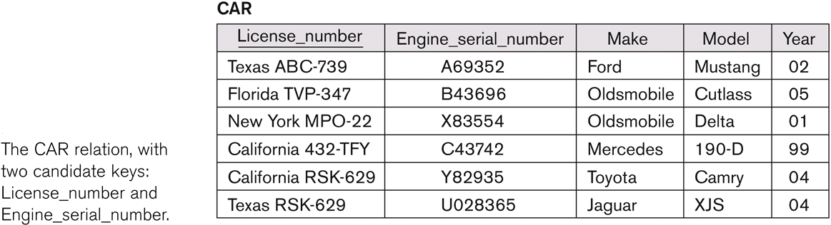
Primary Key (Entity Integrity)

Slide 4
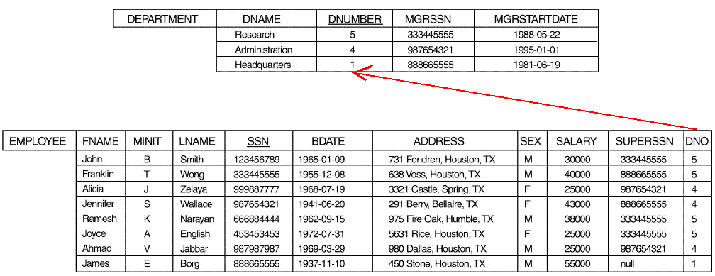
Foreign Key (Referential Integrity)

Slide 5
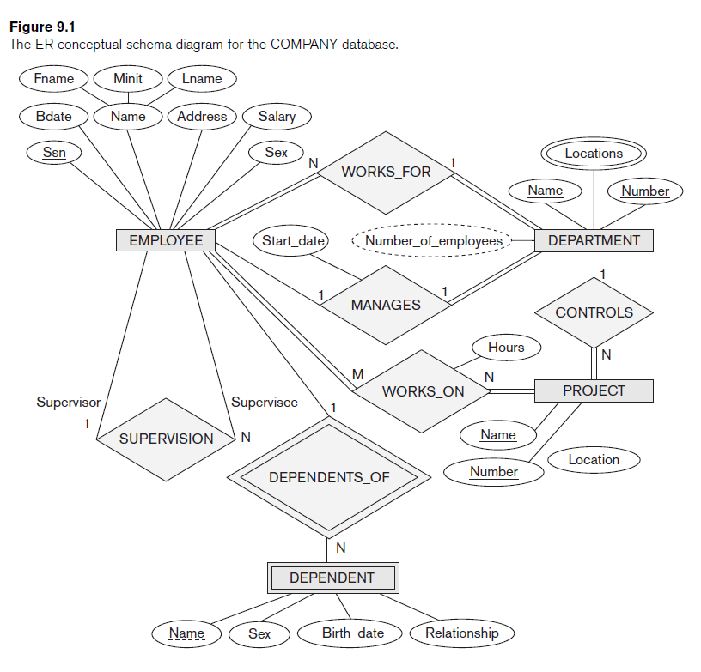

Slide 6
ER-to-Relational Mapping Algorithm
Step 1: Mapping of Regular Entity Types
  For each regular (strong) entity type E in the ER schema, create a relation R that includes all the simple attributes of E
  Choose one of the key attributes of E as the primary key for R.
  If the chosen key of E is composite, the set of simple attributes that form it will together form the primary key of R.
  Example:
  Relations - EMPLOYEE, DEPARTMENT, and PROJECT in the relational schema corresponding to the regular entities in the ER diagram. SSN, DNUMBER, and PNUMBER are the primary keys for the relations EMPLOYEE, DEPARTMENT, and PROJECT respectively.

Slide 7

The ERD for the COMPANY database
Strong Entity Types

Slide 8
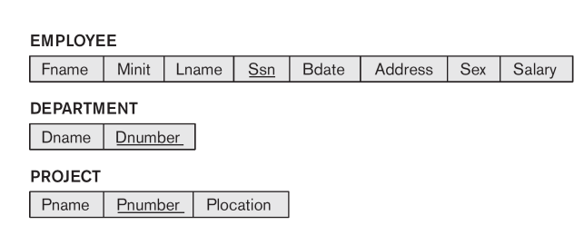
Step 1 Result

Slide 9
ER-to-Relational Mapping Algorithm
Step 2: Mapping of Weak Entity Types
  For each weak entity type W in the ER schema with owner entity type E, create a relation R and include all simple attributes (or simple components of composite attributes) of W as attributes of R
  In addition, include as foreign key attributes of R the primary key attribute(s) of the relation(s) that correspond to the owner entity type(s)
  The primary key of R is the combination of the primary key(s) of the owner(s) and the partial key of the weak entity type W, if any
  Example
  Create the relation DEPENDENT in this step to correspond to the weak entity type DEPENDENT. Include the primary key SSN of the EMPLOYEE relation as a foreign key attribute of DEPENDENT (renamed to ESSN)
  The primary key of the DEPENDENT relation is the combination {ESSN, DEPENDENT_NAME} because DEPENDENT_NAME is the partial key of DEPENDENT

Slide 10
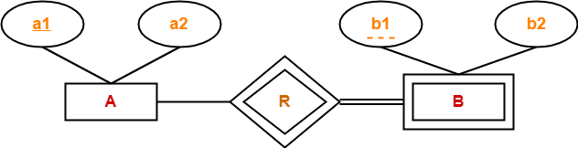
ER-to-Relational Mapping Algorithm
A ( a1 , a2 )
B ( a1 , b1 , b2 )

Slide 11
The ERD for the COMPANY database
Owner’s PK
PK
Weak Entity Types
Partial key

Slide 12
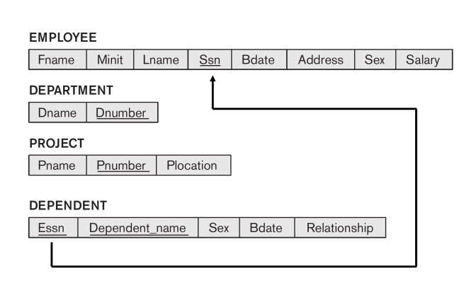
Step 2 Result

Slide 13
ER-to-Relational Mapping Algorithm
Step 3: Mapping of Binary 1:1 Relation Types
  For each binary 1:1 relationship type R in the ER schema, identify the relations S and T that correspond to the entity types participating in R.
  There are three possible approaches
  (1) Foreign Key approach
    Choose the relations with total participation in R – say S - and include T’s primary key in S.
  Example
  1:1 relation MANAGES is mapped by choosing the participating entity type DEPARTMENT to serve in the role of S, because its participation in the MANAGES relationship type is total

Slide 14
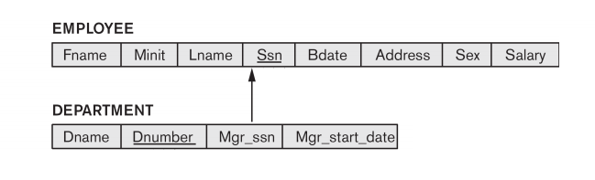
Mapping Binary 1-to-1 Foreign Key Step 3 Result
i. Choose one relation as S, the other T
  Better if S has total participation (reduces number of NULL values)
ii. Add to S all the simple attributes of the relationship
iii. Add as a foreign key in S the primary key attributes of T

Slide 15
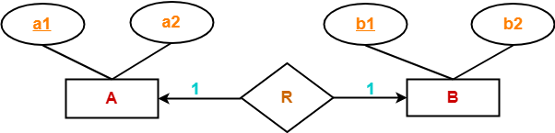
ER-to-Relational Mapping Algorithm
Way-01:
A ( a1 , a2 , b1 )
B ( b1 , b2 )
Way-02:
A ( a1 , a2 )
B ( a1 , b1 , b2 )

Slide 16
ER-to-Relational Mapping Algorithm
  (2) Merged relation option
    An alternate mapping of a 1:1 relationship type is possible by merging the two entity types and the relationship into a single relation. This may be appropriate when both participations are total
  (3) Cross-reference or relationship relation option
    The third alternative is to set up a third relation W(T.primarykey, S.primaryKey) for the purpose of cross-referencing the primary keys of the two relations S and T representing the entity types

Slide 17
ER-to-Relational Mapping Algorithm
Step 4: Mapping of Binary 1:N Relationship Types
  For each regular binary 1:N relationship type R, identify the relation S that represent the participating entity type at the N-side of the relationship type.
  Include as foreign key in S the primary key of the relation T that represents the other entity type participating in R.
  Include any simple attributes of the 1:N relation type as attributes of S.
Example
  1:N relationship types - WORKS_FOR, CONTROLS, and SUPERVISION
  For WORKS_FOR we include the primary key DNUMBER of the DEPARTMENT relation as foreign key in the EMPLOYEE relation and call it DNO

Slide 18
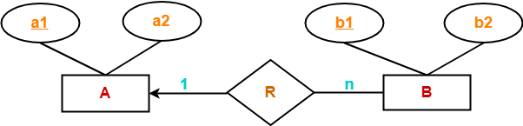
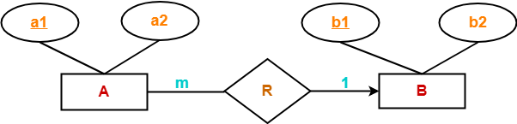
ER-to-Relational Mapping Algorithm
A ( a1 , a2 )
B ( a1 , b1 , b2 )
A ( a1 , a2 , b1 )
B ( b1 , b2 )

Slide 19
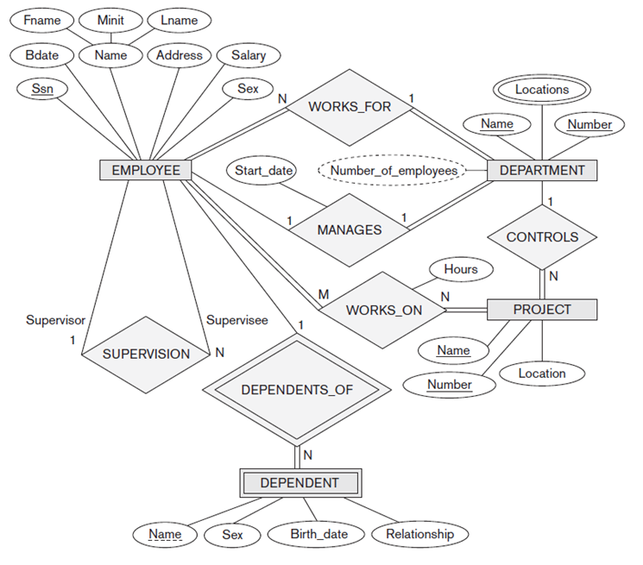

Slide 20
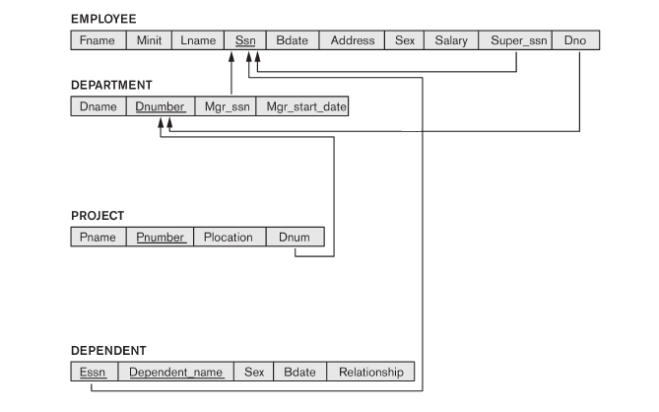
Step 4 Result

Slide 21
ER-to-Relational Mapping Algorithm
Step 5: Mapping of Binary M:N Relationship Types
  For each regular binary M:N relationship type R, create a new relation S to represent R.
  Include as foreign key attributes in S the primary keys of the relations that represent the participating entity types; their combination will form the primary key of S.
  Also include any simple attributes of the M:N relationship type (or simple components of composite attributes) as attributes of S.
Example
  The M:N relationship type WORKS_ON from the ER diagram is mapped by creating a relation WORKS_ON in the relational database schema.
  The primary keys of the PROJECT and EMPLOYEE relations are included as foreign keys in WORKS_ON and renamed PNO and ESSN, respectively.
  Attribute HOURS in WORKS_ON represents the HOURS attribute of the relation type. The primary key of the WORKS_ON relation is the combination of the foreign key attributes {ESSN, PNO}.

Slide 23
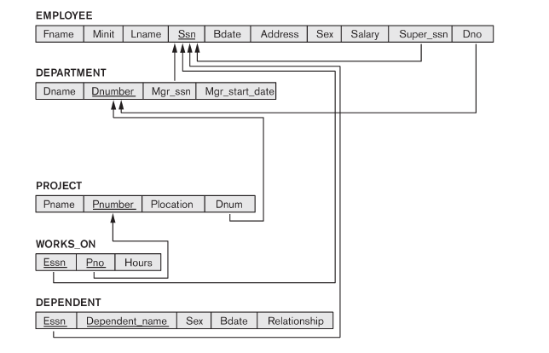
Step 5 Result

Slide 24
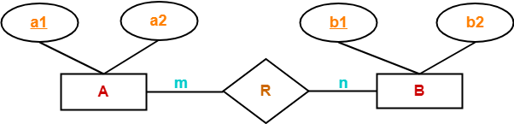
ER-to-Relational Mapping Algorithm
A ( a1 , a2 )
R ( a1 , b1 )
B ( b1 , b2 )

Slide 25
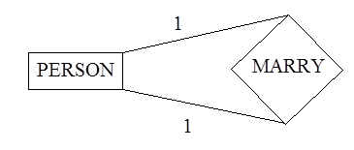
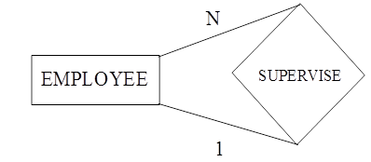
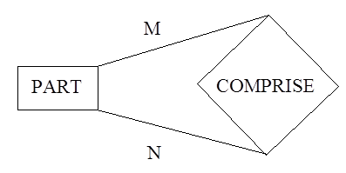
ER-to-Relational Mapping Algorithm
Transformation of recursive relationships
  Relationship among different instances of the same entity
PERSON(ID, NAME, ADDRESS, ...)
MARRY(HUSBAND-ID, WIFE_ID, DATE_OF_MARRIAGE)
EMPLOYEE(ID, ENAME, ..., SUPERVISOR_ID)
PART(PNUMBER, DESCRIPTION, ...)
COMPRISE( MAJOR-PNUMBER, MINOR-PNUMBER, QUANTITY)

Slide 26
ER-to-Relational Mapping Algorithm
Step 6: Mapping of Multivalued attributes
  For each multivalued attribute A, create a new relation R.
  This relation R will include an attribute corresponding to A, plus the primary key attribute K-as a foreign key in R-of the relation that represents the entity type of relationship type that has A as an attribute.
Example
  The relation DEPT_LOCATIONS is created
  The attribute DLOCATION represents the multivalued attribute LOCATIONS of DEPARTMENT, while DNUMBER-as foreign key-represents the primary key of the DEPARTMENT relation
  The primary key of R is the combination of {DNUMBER, DLOCATION}

Slide 27
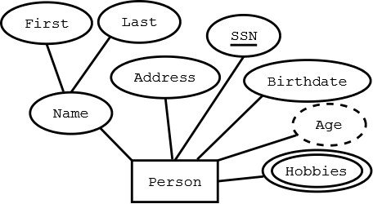
ER-to-Relational Mapping Algorithm
Person(SSN, FirstName, LastName, Address, Birthdate)
Hobbies(SSN, Hobby)

Slide 29
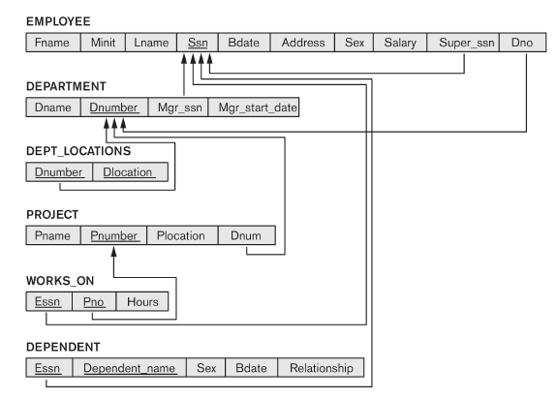
Step 6 Result

Slide 30
ER-to-Relational Mapping Algorithm
Step 7: Mapping of N-ary Relationship Types
  For each n-ary relationship type R, where n>2, create a new relationship S to represent R
  Include as foreign key attributes in S the primary keys of the relations that represent the participating entity types
  Also include any simple attributes of the n-ary relationship type (or simple components of composite attributes) as attributes of S
  Example
    The relationship type SUPPY in the ER on the next slide
    This can be mapped to the relation SUPPLY shown in the relational schema, whose primary key is the combination of the three foreign keys {SNAME, PARTNO, PROJNAME}

Slide 31


ER-to-Relational Mapping Algorithm
Ternary Relationship Types

Slide 32
Summary of Mapping Constructs and Constraints
Correspondence between ER and Relational Models
ER Model Relational Model
Entity type “Entity” relation
1:1 or 1:N relationship type Foreign key (or “relationship” relation)
M:N relationship type “Relationship” relation and two foreign keys
n-ary relationship type “Relationship” relation and n foreign keys
Simple attribute Attribute
Composite attribute Set of simple component attributes
Multivalued attribute Relation and foreign key
Value set Domain
Key attribute Primary (or secondary) key

Slide 34

ER-to-Relational Mapping

Slide 35
Mapping EER Model Constructs to Relations
Step 8: Options for Mapping Specialization or Generalization
  Convert each specialization with m subclasses {S1, S2,….,Sm} and generalized superclass C, where the attributes of C are {k,a1,…an} and k is the (primary) key, into relational schemas using one of the four following options
    Option 8A: Multiple relations-Superclass and subclasses
    Option 8B: Multiple relations-Subclass relations only
    Option 8C: Single relation with one type attribute
    Option 8D: Single relation with multiple type attributes

Slide 36
Mapping EER Model Constructs to Relations
Option 8A: Multiple relations-Superclass and subclasses
  Create a relation L for C with attributes Attrs(L) = {k,a1,…an} and PK(L) = k. Create a relation L_{i} for each subclass S_{i}, 1 < i < m, with the attributesAttrs(L_{i}) = {k} U {attributes of S_{i}} and PK(L_{i})=k. This option works for any specialization (total or partial, disjoint of over-lapping)
Option 8B: Multiple relations-Subclass relations only
  Create a relation L_{i} for each subclass S_{i}, 1 < i < m, with the attributes Attr(L_{i}) = {attributes of S_{i}} U {k,a1…,an} and PK(L_{i}) = k. This option only works for a specialization whose subclasses are total (every entity in the superclass must belong to (at least) one of the subclasses)

Slide 37

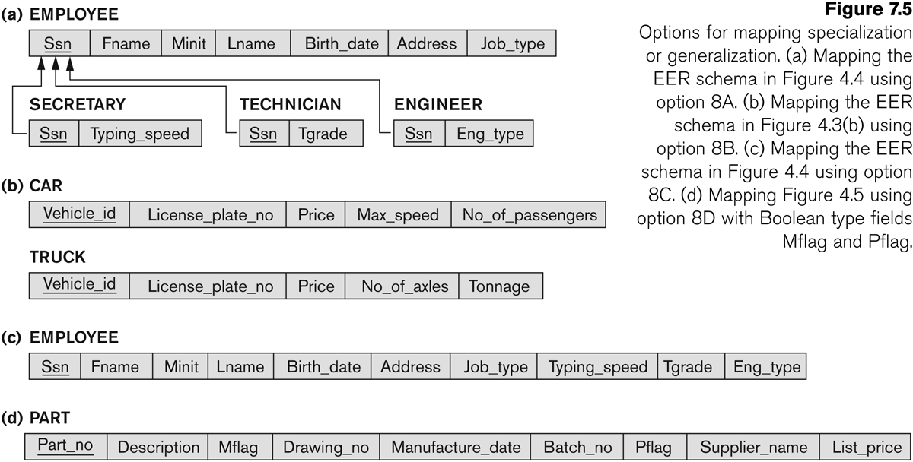
Options for mapping specialization or generalization.
Mapping the EER schema using option 8A

Slide 38
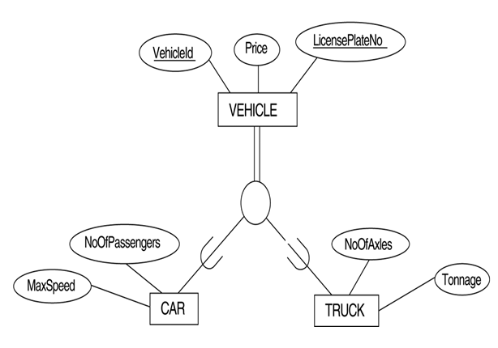
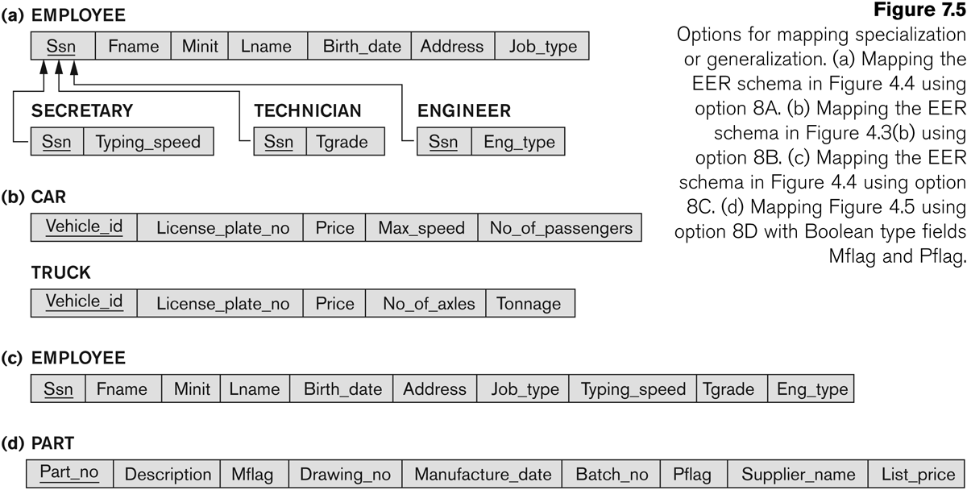
Options for mapping specialization or generalization
Mapping the EER schema using option 8B

Slide 39
Mapping EER Model Constructs to Relations
Option 8C: Single relation with one type attribute
  Create a single relation L with attributes Attrs(L) = {k,a₁,…a_{n}} U {attributes of S₁} U…U {attributes of S_{m}} U {t} and PK(L) = k. The attribute t is called a type (or discriminating) attribute that indicates the subclass to which each tuple belongs
Option 8D: Single relation with multiple type attributes
  Create a single relation schema L with attributes Attrs(L) = {k,a₁,…a_{n}} U {attributes of S₁} U…U {attributes of S_{m}} U {t₁, t₂,…,t_{m}} and PK(L) = k. Each t_{i}, 1 < I < m, is a Boolean type attribute indicating whether a tuple belongs to the subclass S_{i}.

Slide 40
Options for mapping specialization or generalization.
Mapping the EER schema using option 8C

Slide 41

Options for mapping specialization or generalization.
Mapping the EER schema using option 8D; with Boolean type fields Mflag and Pflag.
o

Slide 42
Mapping EER Model Constructs to Relations
Mapping of Shared Subclasses (Multiple Inheritance)
  A shared subclass is a subclass of several classes, indicating multiple inheritance. These classes must all have the same key attribute; otherwise, the shared subclass would be modeled as a category
  We can apply any of the options discussed in Step 8 to a shared subclass, subject to the restriction discussed in Step 8 of the mapping algorithm. Below both 8C and 8D are used for the shared class STUDENT_ASSISTANT

Slide 43

A specialization lattice with
multiple inheritance for a
UNIVERSITY database

Slide 44
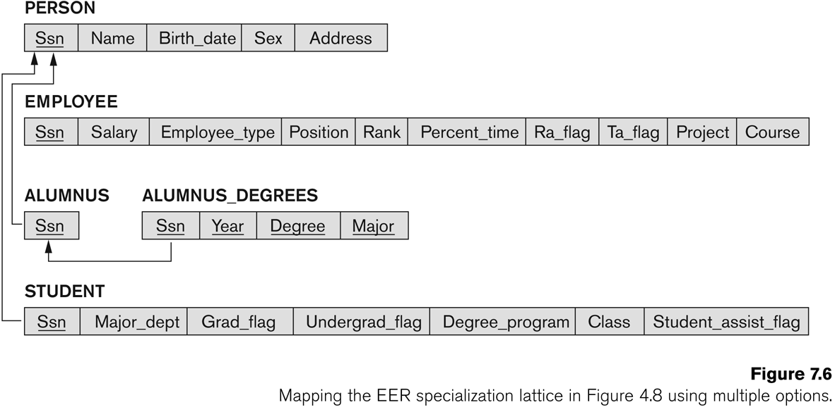
Mapping EER Model Constructs to Relations
8C
8D
8D

Slide 45
Mapping EER Model Constructs to Relations
Step 9: Mapping of Union Types (Categories)
  For mapping a category whose defining superclass have different keys, it is customary to specify a new key attribute, called a surrogate key, when creating a relation to correspond to the category.
  In the example below we can create a relation OWNER to correspond to the OWNER category and include any attributes of the category in this relation. The primary key of the OWNER relation is the surrogate key, which we called OwnerId.

Slide 46
